Slide 1
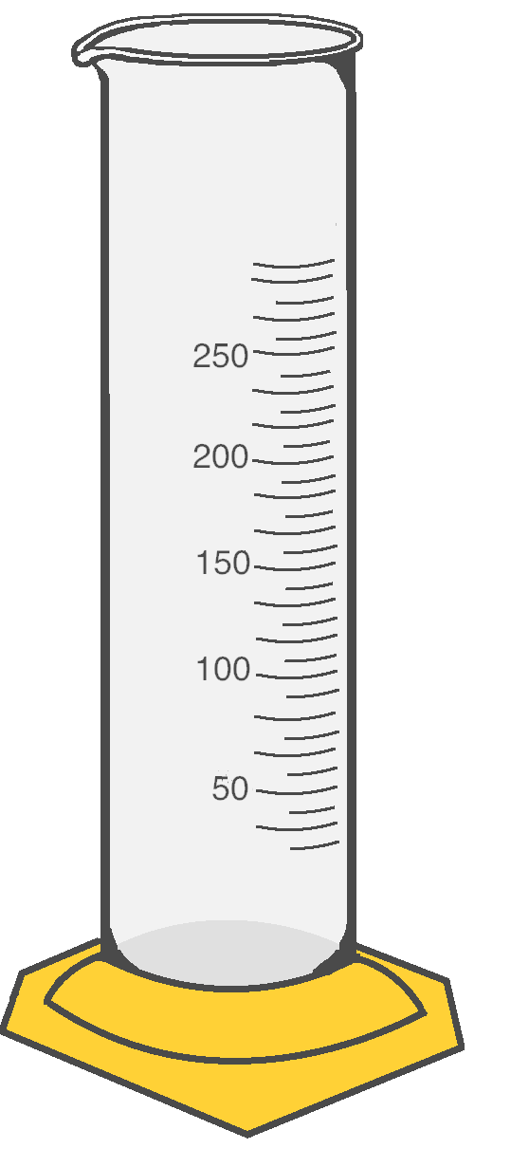
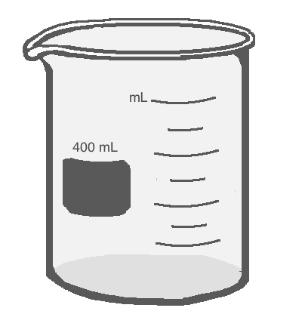


Scientific Method

Slide 2
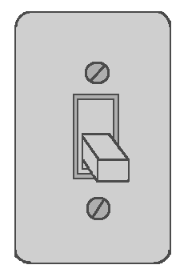
Scientific Method
Every time you solve a problem, you are using the Scientific Method.
You use some form of the Scientific Method everyday without even thinking about it!
For instance, when you walk into a dark room you are faced with a problem: you can’t see. You know that you can turn the lights on with a light switch. You test this by flipping the switch.
If the lights come on, you can conclude that the lights were turned off. If not, you then maybe the bulbs are burnt out. To solve that simple problem, you naturally follow the steps of the scientific method!

Slide 3
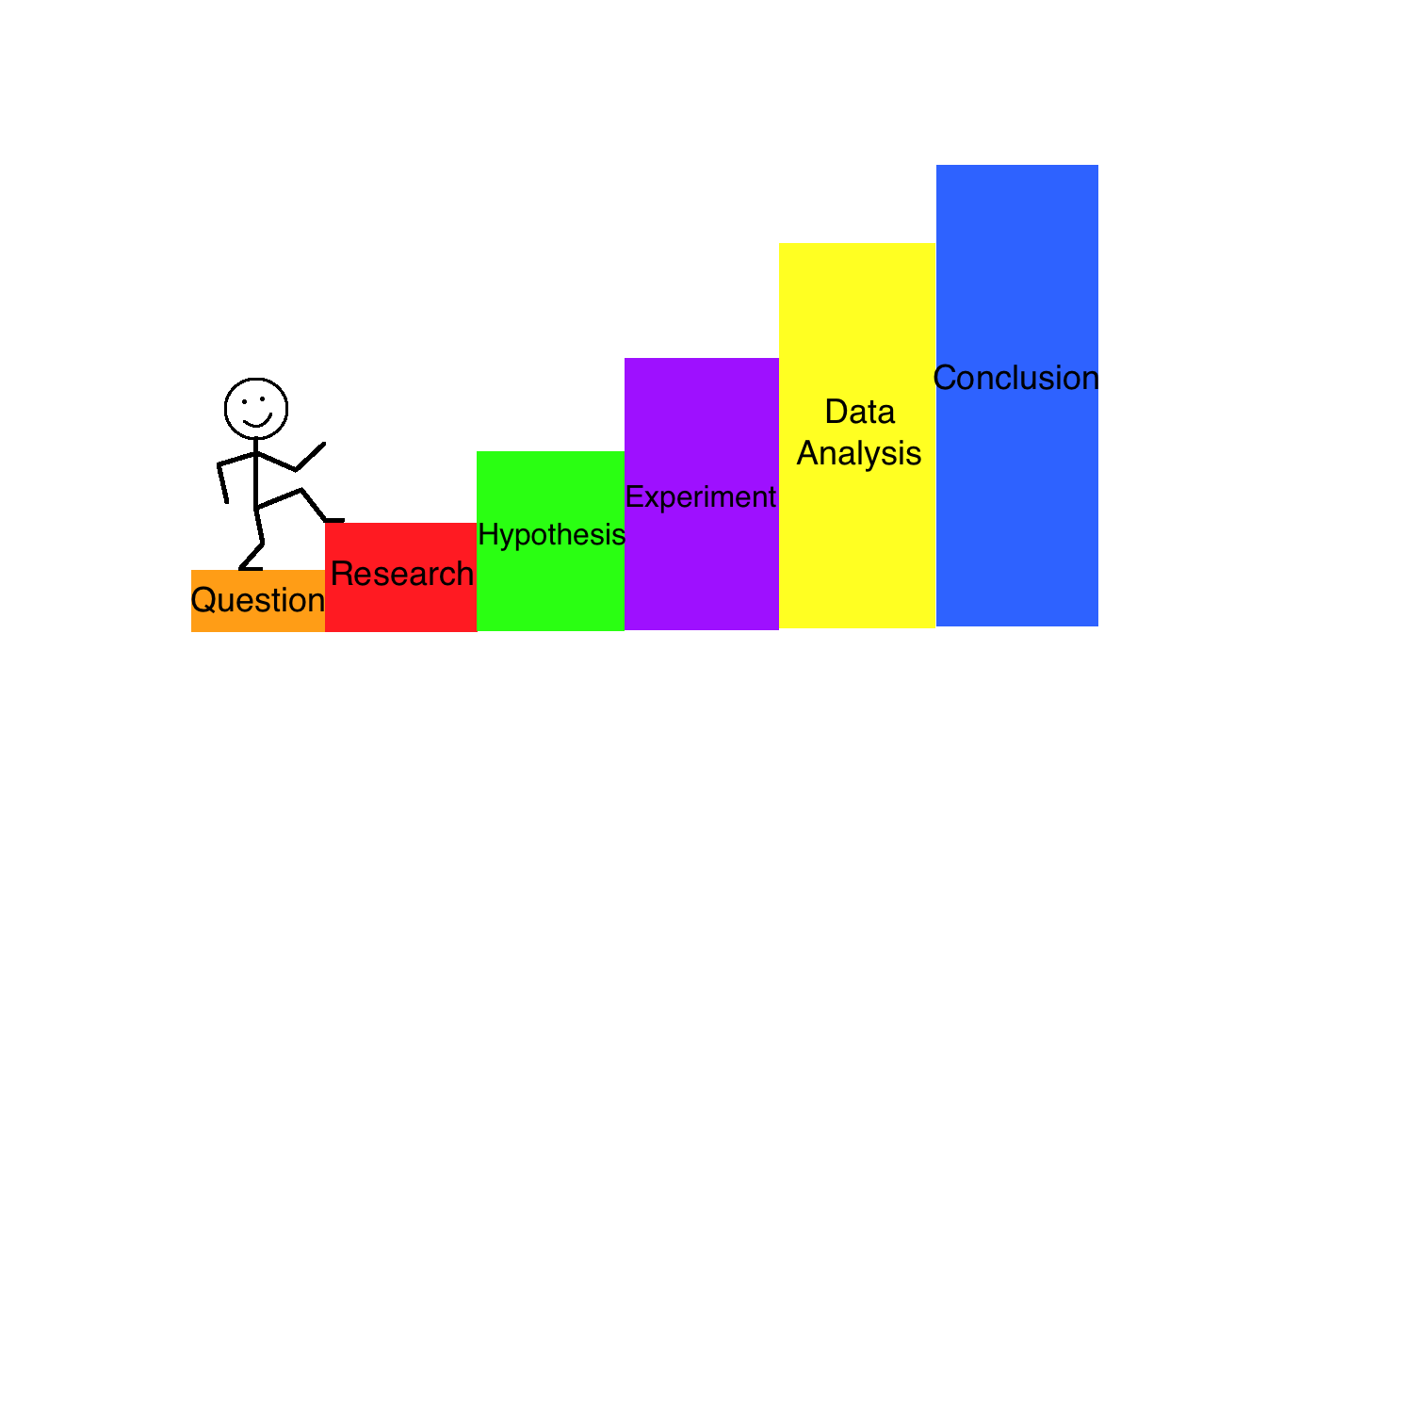
Steps of the Scientific Method
Problem/Question
Research
Hypothesis
Procedure/Experiment
Analyze data
Conclusion
Notes:
Make sure to emphasize to students that the Scientific Method is NOT just a list of steps. We use the scientific method everyday to solve problems we are faced with. If anything, the Scientific Method is just a glorified version of our own natural thought process. However, to go through this process correctly, we cannot neglect the natural chain of events. A question leads to a guess, which leads to us searching for the answer. To prove our guess correct we have to test it by changing something. The proof we gain from changing (testing) will lead us to our conclusion.

Slide 4

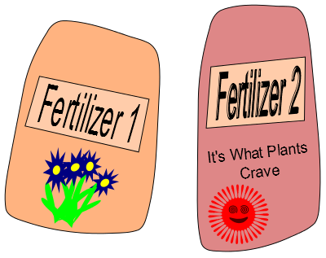
Question
Everyday you are faced with problems or come up with questions. Having a Question is the first step to finding the solution.
For example, you bought seeds for your favorite flower but are not sure what the best fertilizer to use is.
You have two types of fertilizer in your garage so you come up with the Question:
Which fertilizer will make my flower grow taller: Fertilizer 1 or Fertilizer 2?
Notes:
Make sure that students realize that the beginning of the Scientific Method process can begin with a Question OR a Problem…they can be interchangeable. The Scientific Method helps us solve everyday questions or bigger problems that lead to multiple questions.

Slide 5


Research
To begin answering your question, you have to Research the topic your experiment is on.
For example, if you researched plant fertilizers you would find that they have different nutrients in them. Some are better for making plants bigger and some are better for making them flower more.
Different fertilizers have different amounts of these nutrients for the plants.
You see Fertilizer 1 has a lot of flowering nutrients in it while Fertilizer 2 has lot of growth nutrients.
Notes:
Students need to understand that to conduct a scientific experiment correctly, they must research the topic they wish to learn about beforehand. This is because you cannot make an educated guess without having educated yourself on the topic you’re exploring. Researching the topic will also provide enough information to lead to a more accurate and sound experiment.

Slide 6

Hypothesis
After researching your topic you have enough information to predict how your experiment will go. This prediction is called a Hypothesis.
If you use Fertilizer 1 on Plant A and Fertilizer 2 on Plant B, then you can expect Plant B to grow taller because its fertilizer has more growth nutrients.
Notes:
The Hypothesis is a crucial step in the entire Scientific Method. This step is virtually what the entire science experiment is founded upon because it highlights the chosen independent and dependent variables. Students should be aware that this statement is not just a “guess”, it has to include what will be changed in the experiment as well as the reason behind the predicted result. Depending on the grade level or standards your teaching is based upon, you may want to emphasize the “if, then, because” method to writing a Hypothesis. This method will make sure to highlight the independent variable, dependent variable, and research that the experiment will be based upon.

Slide 7


Design the Experiment
Now you have to create an Experiment to test your hypothesis .
You need to figure out what the Variables are. A variable is something that changes (varies). Our variables are:
Type of fertilizer
Which day you measure the height
Height of the plants
There are two types of variables:
Independent Variable: It does not depend on the other variables. This is the variable that you control.
Dependent Variable: This variable depends on the other variables. It is the variable that you are trying to measure.
The Experiment: To test how the height depends on the type of fertilizer used, you will plant the seeds in the same soil, give them the same amount of water, sunlight and fertilizer, but give them different types of fertilizer. Then you will record the heights of the plants as they grow for several days and see which plant grows taller.
A
B
Notes:
Designing the Experiment is a type of extension upon the Hypothesis to provide evidence as to whether your hypothesis will be supported or not supported. The design of the experiment must be based upon the independent variable that is being changed.

Slide 8

Independent Variables
Fertilizer: The type of fertilizer that you use is your choice. It does not depend on the height of the plants or on the day, so it is an Independent Variable.
Day: You will make measurements on different days, but the days do not depend on the fertilizer or on the height of the plants. Therefore, the day is an Independent Variable.
I chose which fertilizer to give the plants and which days to make the measurements!
Notes:
Take a moment to properly word this slide in your explanation. Although there are two independent variables here, there is only one independent variable that we are in control of. In other words there is one “main” independent variable (the fertilizer). The other independent variable (day) is out of our control but also does not depend on the fertilizer or the height, making it an independent variable technically. In other words, make sure that students know that when it comes to Independent Variables, they can only change ONE thing that they are personally controlling in the experiment.

Slide 9
Dependent Variable
I will measure how tall my plants grow!
Height of the Plants: The height of the plants (according to your hypothesis) will change depending on which fertilizer you use. Because this variable depends on another variable it is a Dependent Variable.
Notes:
Make sure that the change you are looking for (dependent variable) is measurable either qualitatively or quantitatively. Emphasize to students this point: all dependent variables MUST be measurable in order to provide evidence for the Hypothesis.

Slide 10
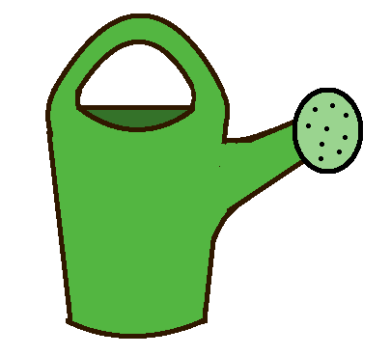

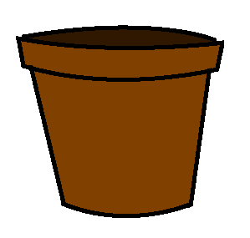

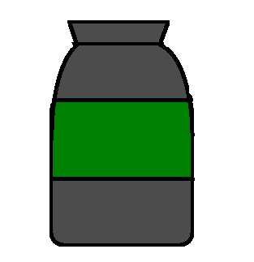
Controls
Controls are the part of an experiment that remain the same no matter what.
In our experiment, our controls for Plant A and Plant B will include:
Plant A and Plant B will be planted using the same exact type of seeds.
Receive the same amount of sunlight everyday.
Receive the same amount of water everyday
Planted using the same type and amount of soil
Given the same amount of their fertilizers (but not the same fertilizer for Plant A as for Plant B)
Height will be measured using the same ruler
Grown in the same type of pot
SEEDS
SOIL
Notes:
This is an extremely important part of a scientific experiment. Make sure that the students understand that literally all aspects of the experiment except for the Independent Variable MUST remain the same. They must also notate these controls somewhere so as to tell what could be improved or what was forgotten in the experiment if the results were abnormal. It only takes one aspect of the experiment not being the same for to make the entire experiment invalid.

Slide 11
Perform the Experiment
You plant the seeds for Plant A and Plant B with the same amount of soil, water, sunlight, and fertilizer.
You give Plant A Fertilizer 1 and Plant B Fertilizer 2.
You record the heights of Plant A and Plant B for 4 days in a row once they start sprouting.
A
B
Notes:
After the controls and variables have all been accounted for and the materials are set up, it is finally time to perform the experiment! A major point in performing the experiment that the kids need to understand is that they must perform the procedures EXACTLY as they are written. If they are creating the science experiment themselves, they need to be VERY conscious as to whether or not their procedures are detailed enough to be repeated.

Slide 12

Make a Table
When doing an experiment, it is always important to record your observations. These observations are the data.
Data is a collection of results and observations that you can refer to later on to help you learn about what happened during your experiment. To organize the data better, we use Tables.
Before starting your experiment, you will draw a blank table and then fill it in as you make observations/collect data.
Tables have columns (vertical – like columns on buildings) and rows (horizontal – like rows of corn across a field).
Variable 1 | Variable 2 | Variable 3 | Variable 4
Data | Data | Data | Data
Data | Data | Data | Data
Data | Data | Data | Data
Notes:
Although making tables seem like an afterthought, they are crucial in expressing the data fully and accurately. This is the place where the full effects of the independent variable on the dependent variable is first visible as data. It is important to emphasize that when they are creating their tables that they USE UNITS. Make sure they understand that it is NEVER acceptable to simply record numbers, this will cause their data to be invalid.

Slide 13
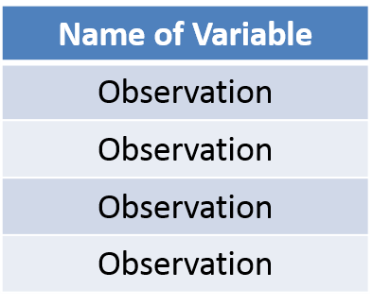
Tables: Columns
Each column of a table is for one variable. If you have three variables, then you will need three columns.
In our experiment we have three variables.
The Day (independent variable)
Height of Plant A (dependent variable)
Height of Plant B (dependent variable)
This is a Column
The top of the column is where you put the name of your variable.
Notes:
This is an optional slide to break down the table if your class is new to the material or having difficulty remembering the basic set up. Make sure to express the difference between columns and rows as simply as it truly is. However, when it comes to variables, make sure that they understand the way variables interact with the columns and rows.

Slide 14
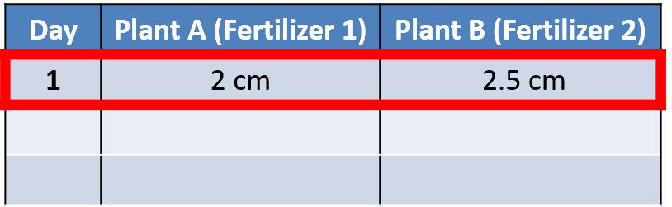
Tables: Rows
The data within a row of a table is related. So, Rows help us organize sets of related data. For example, all of the data on our first row below is from the first day and all of the data taken on the second day will go in the second row.
Let’s say that on Day 1 you measure Plant A to be 2cm tall and Plant B to be 2.5 cm tall.
The first row has each of these observations recorded in the correct columns. The Day column has a 1 in the first row, the Plant A column has 2cm in the first row, and the Plant B column has 2.5 cm in the first row.
This is the first row where we put our first observation for each variable.
This is a Row
Notes:
This is an optional slide to break down the table if your class is new to the material or having difficulty remembering the basic set up. Make sure to express the basic difference between columns and rows as simply as it truly is. However, when it comes to variables, make sure that they understand the way variables interact with the columns and rows.

Slide 15
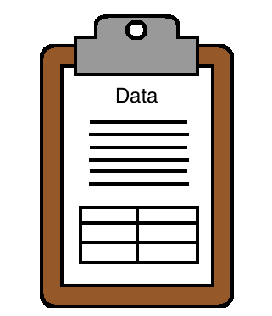
Record the Data
You continue to make measurements of the plants for each day and record the following values:
Day 1: Plant A was 2 cm tall and Plant B was 2.5 cm tall
Day 2: Plant A was 7.5 cm tall and Plant B was 10 cm tall
Day 3: Plant A was 13 cm tall and Plant B was 17 cm tall
Day 4: Plant A was 20 cm tall and Plant B was 25 cm tall
Below is how you would record this data properly in a table:
Day | Plant A (Fertilizer 1) | Plant B (Fertilizer 2)
1 | 2 cm | 2.5 cm
2 | 7.5 cm | 10 cm
3 | 13 cm | 17 cm
4 | 20 cm | 25 cm
Notes:
Make it clear to students how the table is essentially the blank template for their data. Once they have set up the table, they can THEN perform the experiment and record the data. Emphasize again that UNITS are CRUCIAL. Neglecting to record the units along with the numerical data will lead to invalid data. If you are using only the PowerPoint version of this Lesson, you may want to refer to the Worksheet included in the Lesson plan to give your class extra practice on becoming comfortable with graphs. If you are using the interactive online module, there will be an opportunity for your class to practice working with tables using one of the interactive activities.

Slide 16
When you analyze your data, you are trying to make sense of it and learn from it. You should put your data into charts and graphs to help you view your data better.
Charts and graphs help make the data from your table more visual. This will help you spot trends and reach conclusions.
We are going to look at several different graphing and charting techniques that will help you see different aspects of the data. Graphing is one of the most important skills that you will learn in science.
Analyze the Data
Notes:
This is a major step in their entire experiment. Next to running the experiment, this is the most important step towards providing evidence for the hypothesis. The analysis of data is an opportunity for the student to express their data visually and comprehensively. As explained in proceeding slides, there are various ways to express and analyze data, all of which provide different perspectives. These different perspectives collectively allow the student to reach a very accurate conclusion, regardless of whether it supports their hypothesis or not.

Slide 17
Graphs
Graphs display data so that we can see the relationship between two or more variables and better understand our data.
A graph has two main lines, called axes, that meet at the origin at a right angle. The vertical line is called the Y axis and the horizontal line is called the X axis. Each axis is like a number line, and the numbers on the axis are called coordinates.
We use the Y axis to show the dependent variable and the X axis to show the independent variable.

Slide 18
Graphs
Y Axis
Graphs show us the relationship between two Variables. Graphs display data so that we can see and understand it more clearly. A Graph is usually made of two lines that form a right angle and where those two lines meet is called the origin. These lines are called Axes. The vertical line on the graph is called the Y Axis and the horizontal line on the graph is called the X axis. The Y Axis represents the Dependent Variable and the X Axis represents the Independent Variable. One of the most important parts about graphs is that they allow us to see Patterns and Trends within our data.
Dependent Variable
Origin
X Axis
Independent Variable

Slide 19
Independent Variable
Y Axis
An Independent Variable is the part of the experiment that you choose to change. When you change something in an experiment you are trying to find the answer to your problem or question. The Independent variable in our example experiment is changing which type of fertilizer the two plants are given. This is the independent variable in this experiment because we are controlling the type of fertilizer Plant A and Plant B receive. The Independent Variable will always be shown on the X axis (horizontal axis) of the graph.
X Axis
Independent Variable

Slide 20
Dependent Variable
Dependent Variable
Y Axis
The Dependent Variable is the part of the experiment that you can not directly control. It is the variable that you want to measure in the experiment. The Dependent Variable in our example experiment is the height of your two plants. This is the dependent variable because it is the change that we can not control, the change in the plants’ height depends on which fertilizer they are given. The Dependent Variable will always be shown on the Y axis (vertical axis) of the graph.
X Axis

Slide 21
Patterns
Y Axis
Graphs are a major way that we express data so that we can visualize our data better. Graphs also allow us to see Patterns that form in our data. A Pattern is when data is repeated in a way that shows a sequence.
For example, this line is increasing. This is a pattern because each individual point that makes up the line is increasing. So, the data points form a pattern and when they are put into a graph, it gives us a larger picture. This larger picture makes it very clear to see that our data points are increasing.
Increasing points create a pattern
X Axis

Slide 22
Bar Graphs
Effect of Type of Fertilizer on Plant Growth
Y Axis
30
Bar Graphs are used to show the total change in something.
For our example, we took the final height of Plant A and the final height of Plant B from our chart and displayed it on this graph. As you can see, the Independent Variable (the type of fertilizer used) goes on the X axis. The Dependent Variable (the height of the plant) goes on the Y axis. By displaying our data this way, we are able to easily see that Plant B grew taller using Fertilizer 2 than Plant A did using Fertilizer 1.
25
20
Plant Height (cm)
15
Plant A
Plant B
10
5
X Axis
Fertilizer 1
Fertilizer 2
Type of Fertilizer Used

Slide 23
Line Graphs
Effect of Type of Fertilizer on Plant Growth
Y Axis
30
Line Graphs show how something changes over time. Line graphs help us see trends (patterns) in how things change over time.
For our example, we took all of the height measurements for Plant A and Plant B from our chart and displayed it on this graph. As you can see, the Independent Variable (the type of fertilizer used) goes on the X axis. The Dependent Variable (the height of the plant) goes on the Y axis. Since this graph includes time, it helps us see that Plant B grew taller AND faster than Plant A.
25
Key
20
Plant A (Fertilizer 1)
Plant Height (cm)
15
Plant B (Fertilizer 2)
10
5
X Axis
1
2
3
4
Day

Slide 24
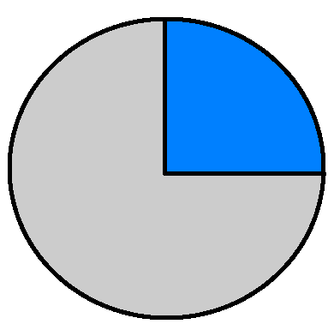
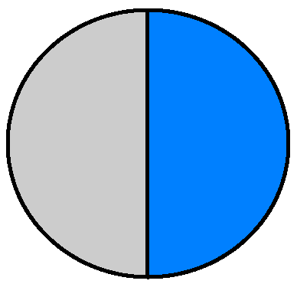
Pie Charts
Plant Growth Chart
 | 1st Plant | 2nd Plant | 3rd Plant | 4th Plant
Fertilizer 1 | 18 cm | 16cm | 19cm | 21 cm
Fertilizer 2 | 22 cm | 19cm | 24 cm | 17cm
Pie Charts help us look at fractions of a whole. Percentages and fractions represent what proportion of a group had a certain result.
For our example experiment, we decided to do multiple trials of testing Fertilizer 1 and Fertilizer 2. This time, we wanted to see how many plants grew over 20 cm for fertilizer 1 and fertilizer 2. We decided to test four plants using Fertilizer 1 and four plants using Fertilizer 2. The table expresses the results of the experiment. As you can see, it is much easier to understand the percentage of plants that grew over 20 cm for fertilizer 1 versus fertilizer 2 when it is in the form of pie charts.
25% Grew over 20 cm
50%
50% Grew over 20 cm
75%
Fertilizer 1
Fertilizer 2

Slide 25
Conclusion
After analyzing all of your data by creating different types of graphs, it is clear that using Fertilizer 2 made Plant B grow taller than Plant A. The Bar Graph helped you understand that after four days, Fertilizer 2 helped Plant B grow to 25 centimeters while Fertilizer 1 only helped Plant A grow to 20 centimeters. The Line Graph helped you see that Fertilizer 2 helped Plant B grow taller and faster than Fertilizer 1 did for Plant A. When you completed this experiment multiple times to create your pie charts, you also learned that Fertilizer 2 consistently makes plants grow taller than Fertilizer 1. All of these different expressions of your results helps you to reach your conclusion.
Let’s think back to our Question: What type of fertilizer will make my favorite type of flower grow the tallest, Fertilizer 1 or Fertilizer 2?
Based on your results and graphs, we can come up with a conclusion/answer to the above question:
Fertilizer 2 helped Plant A reach 25cm while Fertilizer 1 only helped plant B reach 20cm. When this experiment was repeated, Fertilizer 2 consistently produced taller plants than Fertilizer 1. Overall, Fertilizer 2 will help make my favorite type of flower grow the tallest.

